Slide 1

Building Data Systems with Logs

Slide 2
The role of log
There is an analogy here between the role a log serves for data flow inside a distributed database and the role it serves for data integration in a larger organization：
日志在分布式数据库内部数据流中及其在更大组织的数据集成中所起的作用类似：
In both cases, it is responsible for data flow, consistency, and recovery.
均负责数据流处理、数据一致性以及数据恢复
you can see the whole of your organization’s systems and data flows as a single very complicated distributed database.
我们可以将整个组织中的所有系统和数据流视作一个复杂的分布式数据库
1）You can view all the individual query-oriented systems (Redis, SOLR,
Hive tables, and so on) as just particular indexes on your data.
可以将各个面向查询的系统（例如Redis, SOLR, Hive tables 等）视作数据
的索引。
2）You can view a stream processing system like Storm or Samza as just a
very well-developed trigger-and-view materialization mechanism.
可以将流数据处理系统，比如Storm或者Samza 作为功能更为完善的触发器
-视图机制的具体实现。

Slide 3
当前的困境和解决思路
There is now undeniably an explosion of types of data systems，organizations have many relational databases.
当前有大量各种类型的数据系统，一个组织内部有很多关系型数据库。
There are many motivations for segregating data into multiple systems: scale, geography, security, and performance isolation are the most common.
造成这种现象有很多因素：数据规模、地理位置、以及性能隔离（最普遍的原因）
一种解决方法：
It is possible for an organization to have a single Hadoop cluster that contains all the data and serves a large and diverse constituency
Hadoop 集群可以存储组织中的所有数据，并提供一致性服务
Instead of running many little single server instances of a system, you can instead run one big multitenant system shared by all the applications of an entire organization. This allows for huge efficiencies in management and utilization.
所有的应用共享一个大的集群的方式可以用来代替一个组织中运行各种小的系统，这样可以大大提高管理效率。

Slide 4
如何实现组织内部的数据集成？
Open source: data infrastructure could be unbundled into a collection of services and application-facing system API.
You already see this happening to a certain extent in the Java stack：
Zookeeper handles much of the system coordination.
Mesos and YARN process virtualization and resource management.
Embedded libraries like Lucene, RocksDB, and LMDB do indexing.
Netty, Jetty, and higher-level wrappers like Finagle and rest.li handle remote communication.
Avro, Protocol Buffers, Thrift, and umpteen zillion other libraries handle serialization.
Kafka and BookKeeper provide a backing log.
It starts to look like a LEGO version of distributed data system engineering.

Slide 5
The Place of the Log in System Architecture
Handle data consistency (whether eventual or immediate) by sequencing concurrent updates to nodes
通过记录数据更新的时序信息实现数据一致性
Provide data replication between nodes
提供节点间数据复制功能
Provide “commit” semantics to the writer (such as acknowledging only
when your write is guaranteed not to be lost)
提供commit元语
Provide the external data subscription feed from the system
提供外部系统对本系统数据的订阅功能
Provide the capability to restore failed replicas that lost their data or bootstrap new replicas
提供数据副本恢复能力或者启动一个新的副本
Handle rebalancing of data between nodes
实现数据节点间的均衡
This is actually a substantial portion of what a distributed data system does. In fact, the majority of what is left over is related to the final client-facing query API and indexing strategy.
这是一个分布式数据系统的主要功能，剩下的就是关于客户端查询API以及索引策略。

Slide 6
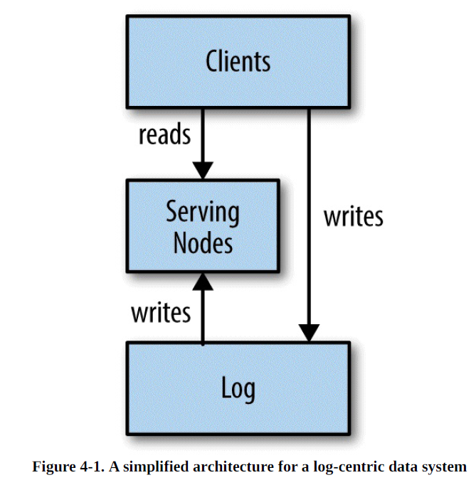
简单的日志为中心的数据系统
The system is divided into two logical pieces: the log and the serving layer.
The log captures the state changes in sequential order.
The serving nodes store whatever index is required to serve queries.

Slide 7
The client can get read-your-write semantics from any node by providing the timestamp of a write as part of its query.
客户端查询时提供 特定的更新时间戳，可实现read-your-write 语义的读取
A serving node receiving such a query will compare the desired timestamp to its own index point, and if necessary, delay the request until it has indexed up to at least that time to avoid serving stale data.
服务节点接收到查询请求，会根据查询请求中的时间戳返回数据。如果请求的时间戳对应的数据还没最后生成，服务节点将会等待数据生成以避免数据脏读。
The serving nodes may or may not need to have any notion of mastership or leader election. For many simple use cases, the serving nodes can be completely without leaders , since the log is the source of truth.
在很多简单的系统中，服务节点没有leader节点，不需要leader选举，因为在日志中记录了真实的数据操作情况。

Slide 8
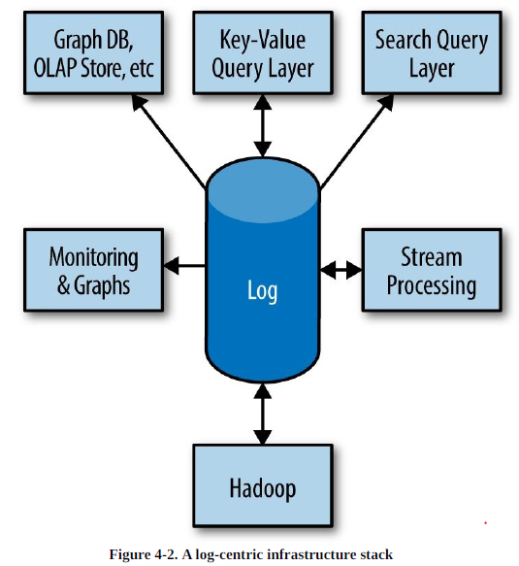
Many systems can share the same log while providing different indexes
Such a log-centric system is itself immediately a provider of data streams for processing and loading in other systems.
Likewise, a stream processor can consume multiple input streams and then serve them via another system that indexes that output.

Slide 9
日志的存储开销与价值
The idea of having a separate copy of data in the log strikes many people as
wasteful.
In reality, there are a few factors that make this less of an issue：
The log can be a particularly efficient storage mechanism . We have the better part of a petabyte (PB) of log storage in Kafka in our live data-centers.
The log system does only linear reads and writes, so it is quite happy using large multiterabyte hard drives.
The data is served by multiple systems, the cost of the log is amortized over multiple indexes . This combination makes the expense of an external log fairly minimal.

Slide 10

HDFS 逻辑架构

Slide 11
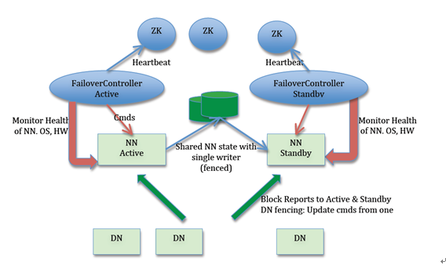
HDFS 组件架构

Slide 12
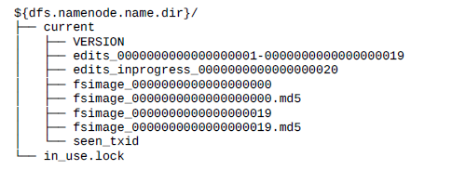
HDFS namenode 架构
NameNode 在执行 HDFS 客户端提交的创建文件或者移动文件这样的写操作的时候，会首先把这些操作记录在 EditLog 文件之中，然后再更新内存中的文件系统镜像。
Notes:
每个segment多大？

Slide 13
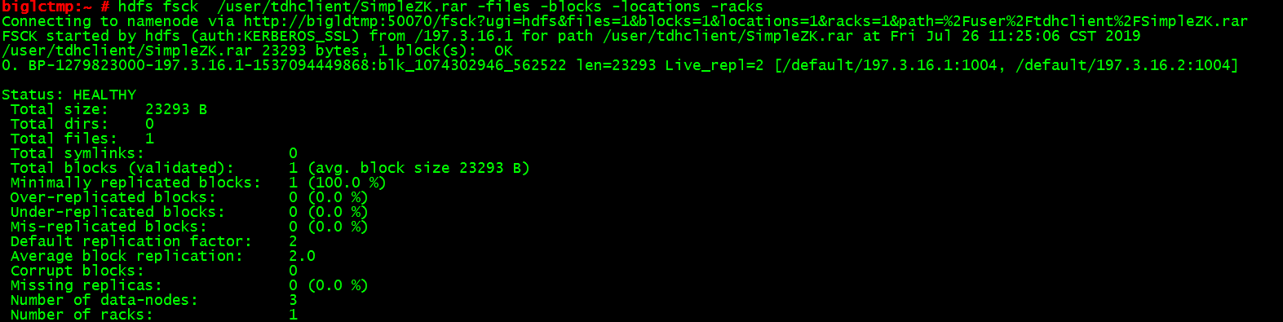
查看数据分布情况
Notes:
每个segment多大？

Slide 14
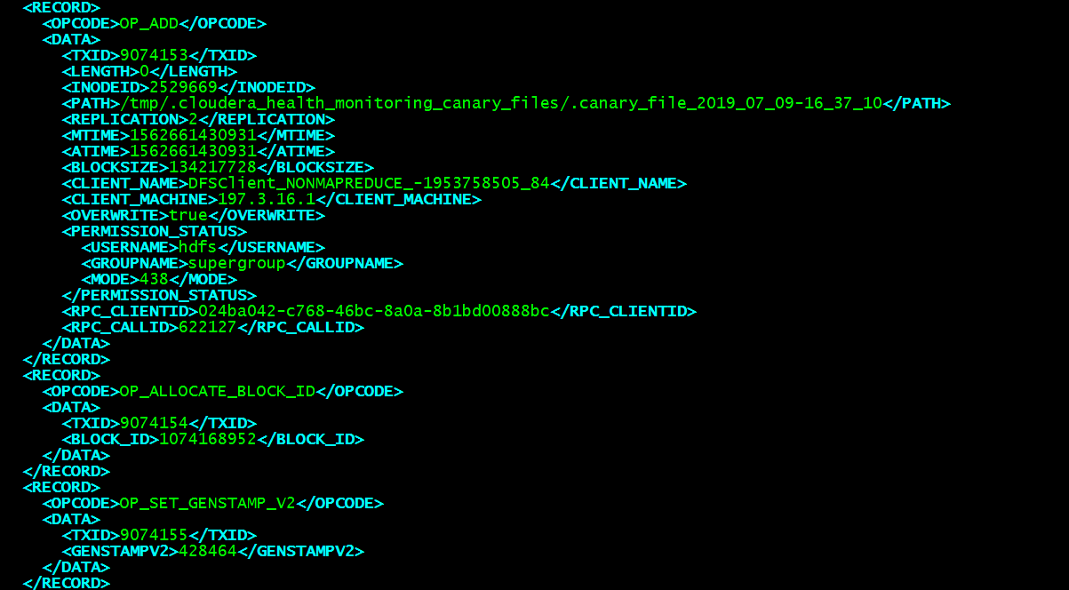
查看edits 文件
hdfs oev -p XML -i edits-path -o edits.xml
Notes:
每个segment多大？

Slide 15
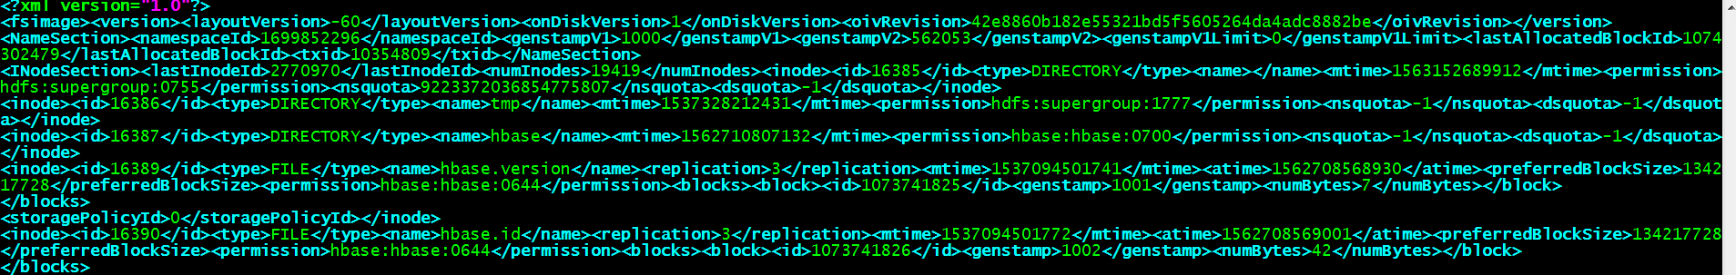
查看fsimage 文件内容
hdfs oiv -p XML -i fsimage-path -o fsimage.xml
Notes:
每个segment多大？

Slide 16
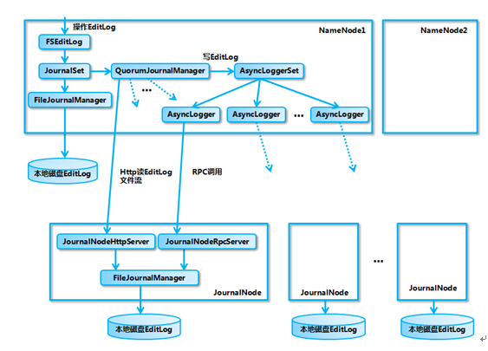
基于QJM 的共享存储系统的内部实现架构图

Slide 17
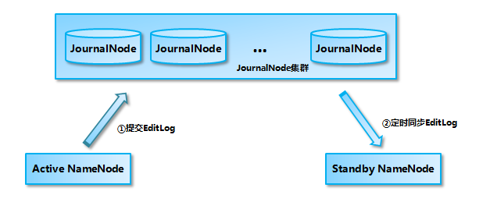
QJM
Active NameNode 首先把 EditLog 提交到 JournalNode 集群，然后 Standby NameNode 再从 JournalNode 集群定时同步 EditLog
Active NameNode 同时向本地磁盘和 JournalNode 集群写 EditLog。提交 EditLog 失败会导致 Active NameNode 退出，留待处于 Standby 状态的 NameNode 接管之后进行数据恢复。
Standby NameNode 定期从 JournalNode 集群同步 EditLog，然后把同步的 EditLog 回放到内存之中的镜像上

Slide 18
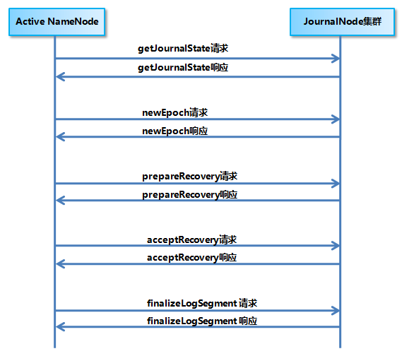
QJM 数据恢复机制

Slide 19
QJM 数据恢复机制
1. Active NameNode 首先向 JournalNode 集群发送 getJournalState RPC 请求，每个 JournalNode 会返回自己保存的最近的那个 Epoch。
2. NameNode 选择最大的一个加 1 作为当前的新 Epoch，然后向各个 JournalNode 发送 newEpoch RPC 请求。
3. JournalNode 在收到新的 Epoch 之后，返回它自己的本地磁盘上最新的一个 EditLogSegment 的起始事务 id
4. NameNode 最大的 id 作为要进行数据恢复的 EditLog Segment 的 id。
5. NameNode 接下来向 JournalNode 集群发送 prepareRecovery RPC 请求
6. JournalNode 收到请求后返回本这个 Segment 的起始事务 id、结束事务 id 和状态 (in-progress 或 finalized)。
7. NameNode 根据 prepareRecovery 的返回结果，选择一个 JournalNode 上的 EditLog Segment 作为同步的基准数据源。
8. NameNode 向 JournalNode 集群发送 acceptRecovery RPC 请求， JournalNode 从基准数据源 JournalNode 上下载 EditLog Segment
9. NameNode 向 JournalNode 集群发送 finalizeLogSegment RPC 请求，JournalNode 接收到请求之后，将对应的 EditLog 转换为 finalized 状态

